Slide 1
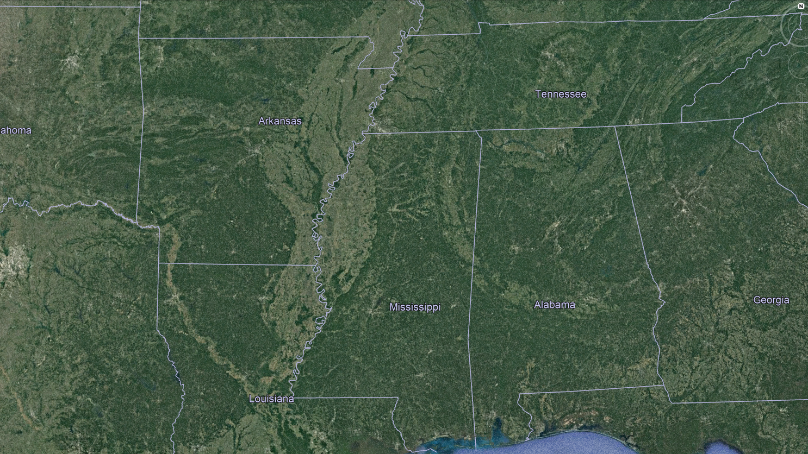

Slide 2
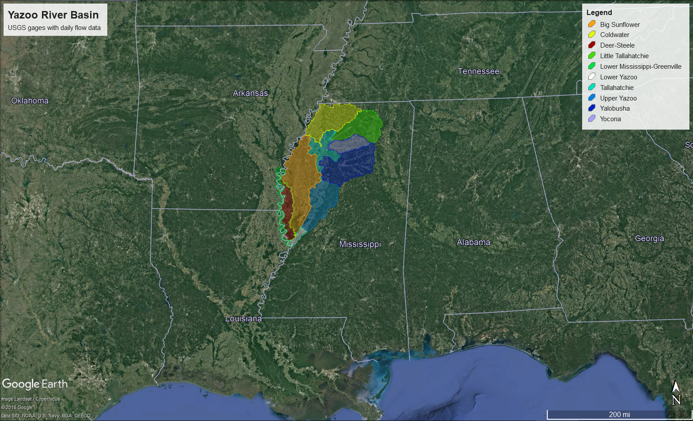

Slide 3
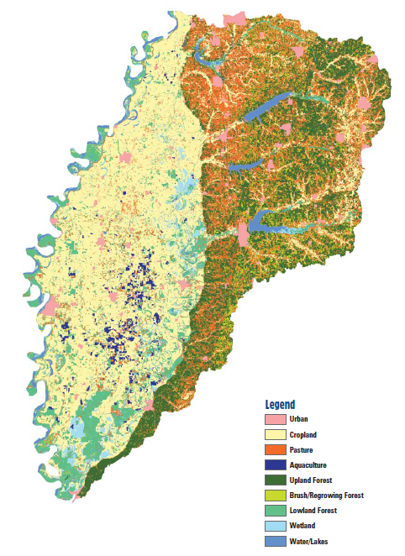
Land use of the Yazoo River Basin
Flood Control Reservoirs:
Arkabutla (1943): 1,000 mi² drainage
Sardis (1940): 1,545 mi² drainage
Enid (1952): 560 mi² drainage
Grenada (1954):1,320 mi² drainage
Total area: 13,510 mi²
41% cropland
30% forested
12% wetland
10% pasture
4% urban
3% water
30% of land area in state
20% of state population
Parajuli and Kim (2012)
...wood in the streams and bayous of the Yazoo-Mississippi Delta was extensive before large-scale deforestation occurred.
Bryant (2010)
Image: MDEQ (2008)

Slide 4
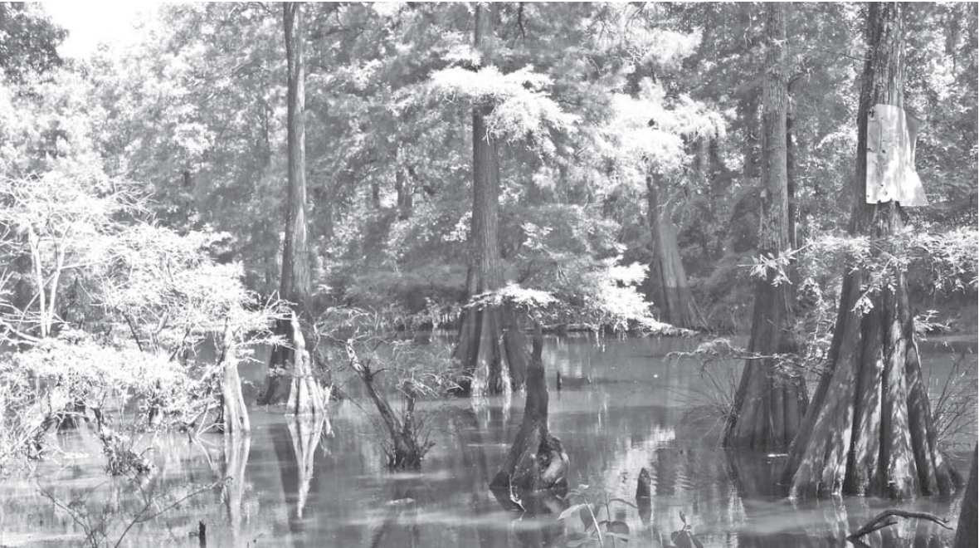
Historically, the Yazoo delta plain was heavily forested in riparian areas
Tree growth and frequent flooding resulted in uneven micro-topographic features (1-3 meters in elevation)
Extensive canebrakes along natural levees – possibly at the site of pre-European agricultural disturbances
Log-jams from stream-side forests were common throughout Delta Plain
Large-scale logging and removal of log-jams occurred by late 1800s
Forested LULC and log-jam evidence dates back to Hernando DeSoto’s explorations (1541)
Ten-mile Bayou in Delta National Forest Bryant (2010)

Slide 5
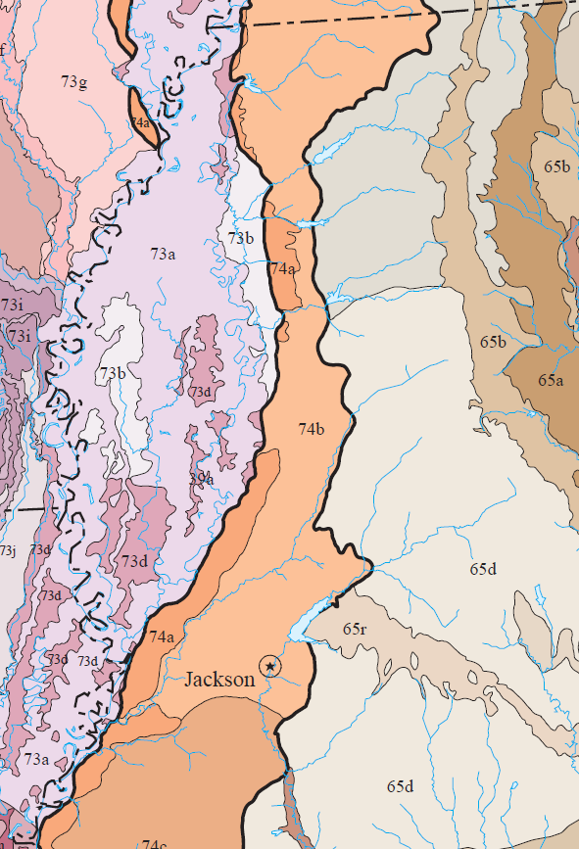
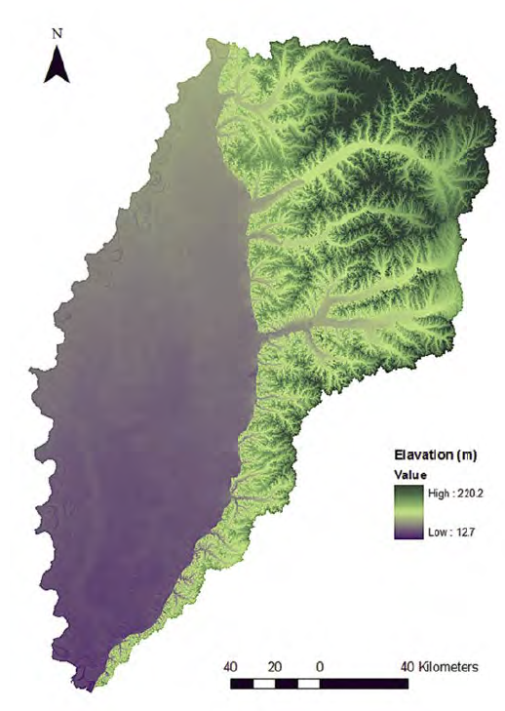
Ecoregions of the Yazoo River Basin
73 – Mississippi Alluvial Plain
73a – Northern Holocene Meander Belts
73b – Northern Pleistocene Valley Trains
73d – Northern Backswamps
74 - Mississippi Valley Loess Plains
74a – Bluff Hills
74b – Loess Plains
65 – Southeastern Plains
65b – Flatwoods/Blackland Prairie Margins
65d – Southern Hilly Gulf Coastal Prairie
65e – Northern Hilly Gulf Coastal Prairie
Image: USEPA (2018)
Image: Parajuli and Kim (2012)

Slide 6
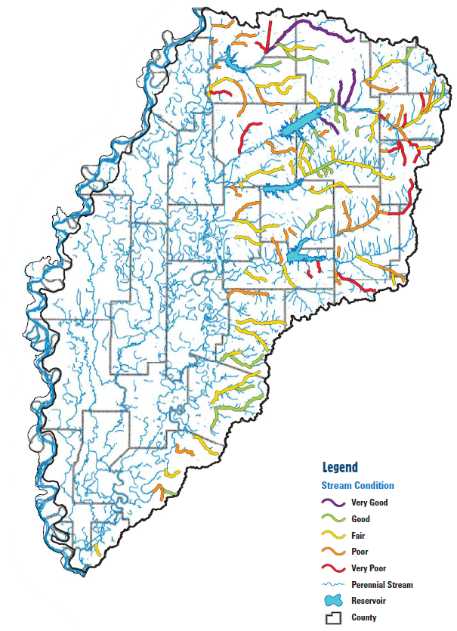
Water Quality Concerns
“Significantly impacted” aquatic life
“Adequately support” aquatic life
“Somewhat impacted” aquatic life
Pollutants include: organic and nutrient enrichment from animal wastes and failing septic systems, bacteria from those same sources, and sediment from eroding lands (pasture, timber operations, new development).
- MDEQ (2006)
Image: MDEQ (2006)

Slide 7
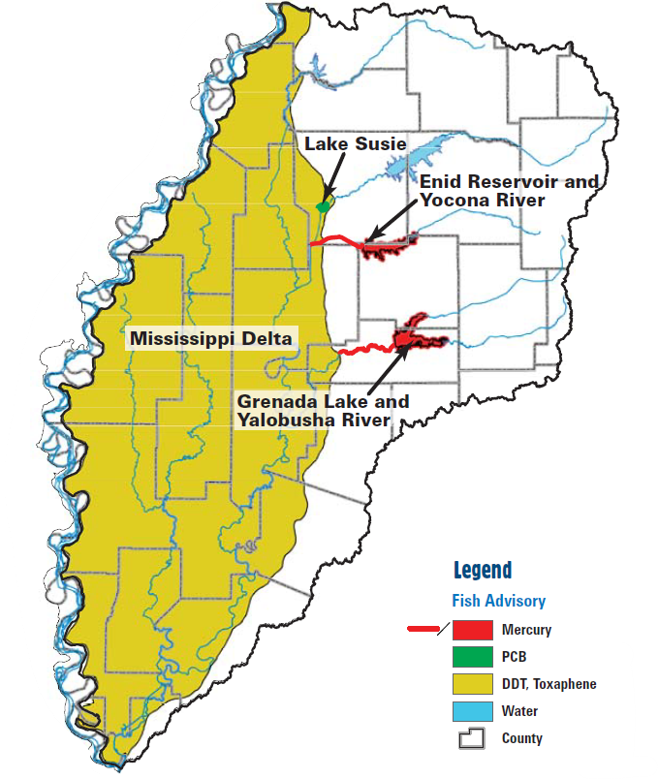
Water Quality Concerns and Impact on Fisheries
Of 134 fish species found in the portion of the Lower Mississippi Alluvial Valley within the state, 102 species can be found in the Yazoo Delta Plain
Paddlefish and sturgeon found in Yazoo and Sunflower tributaries to the Mississippi River
Sport fish (bluegills, sunfish, largemouth bass, crappies) are found in the oxbow lakes of the Delta Plain
Turbidity of waters may prevent some species from being more prevalent
Bryant (2010)
Toxicity sampling has been conducted and resulted in fish advisories for the Delta Plain
Limit consumption of: carp, buffalo, gar, and large catfish
Okay to consume: bass, bream, crappie, freshwater drum, small (or farm-raised) catfish
Waters within Mississippi River levees are okay
MDEQ (2010)
Image: MDEQ (2006)

Slide 8
Yazoo River Basin Watershed Assessment
Problem Statement/Research Question
To what extent do the four flood control reservoirs in the Bluff Hills impact seasonality of water flows and nutrients of concern in the Yazoo River Basin?
All four reservoirs are located in the Bluff Hills, which have very different land use/agricultural practices than the Delta Plain. These disparate systems experience the same climatology; therefore, can a paired watershed approach be designed to assess relative differences between a variety of mitigation/restoration techniques?
Eric White | Tulane University | RCSE-6840 | April 25, 2012

Slide 9
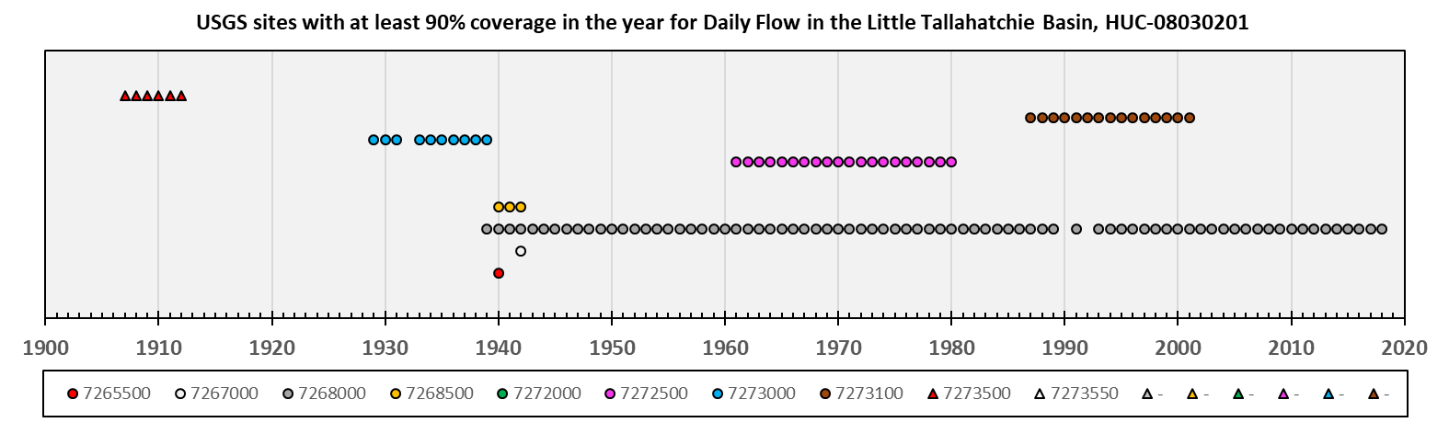
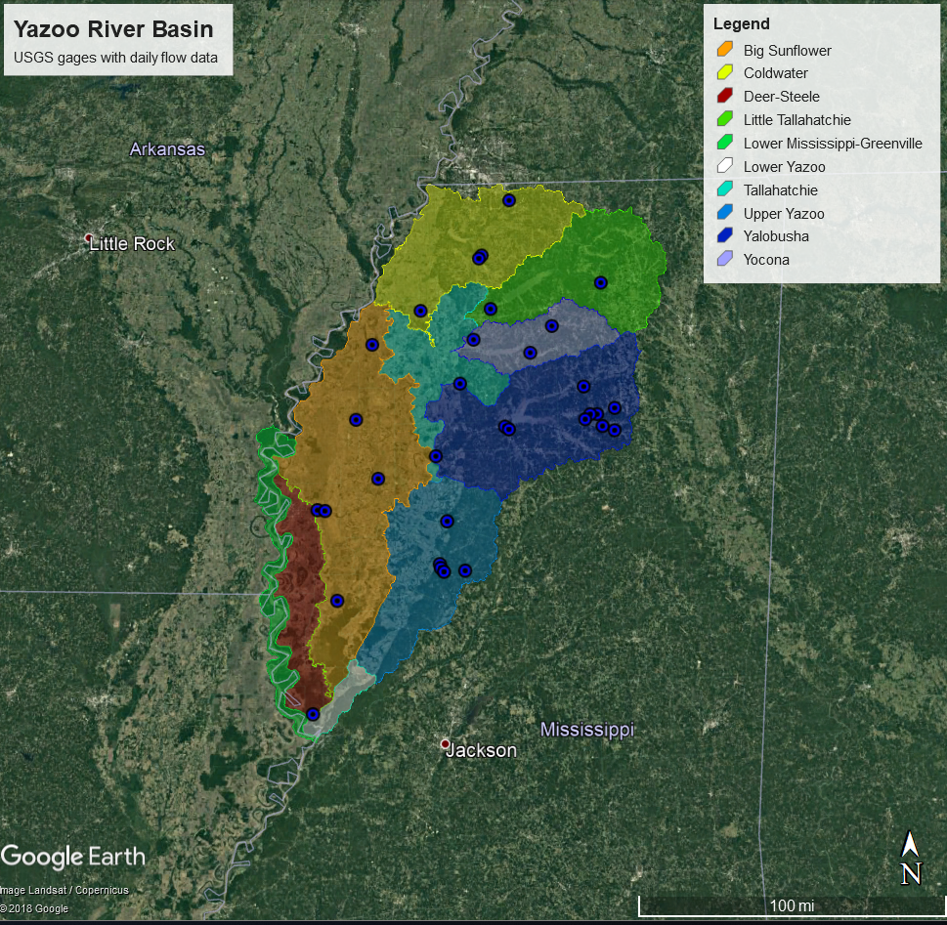
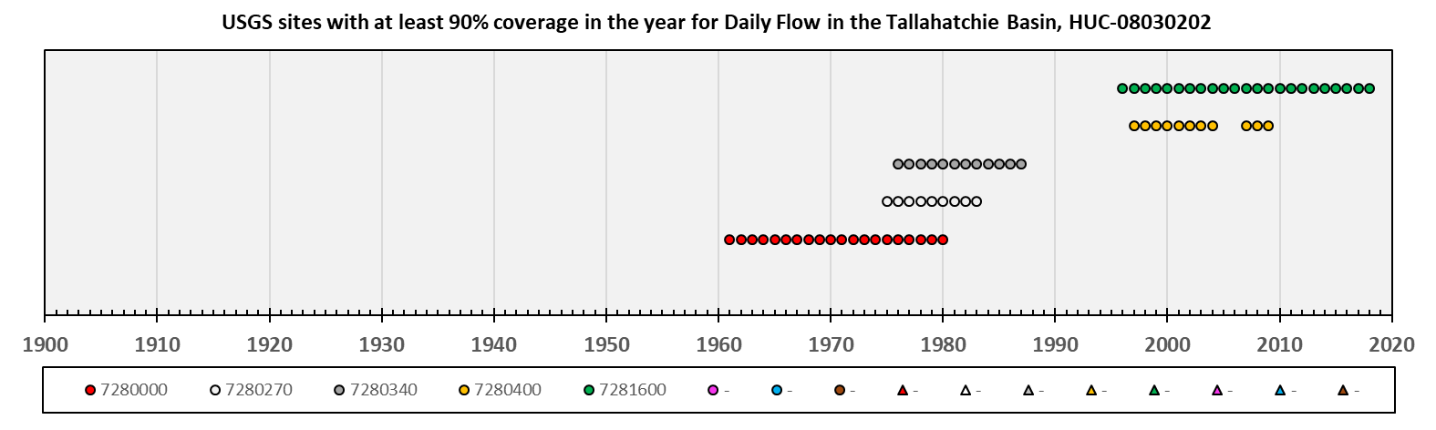
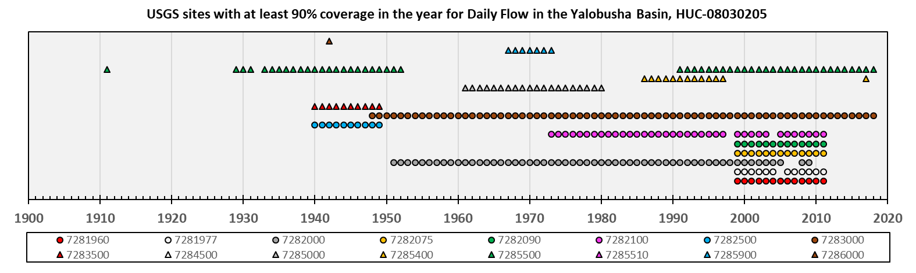
Flow data coverage in the Bluff Hills basins

Slide 10
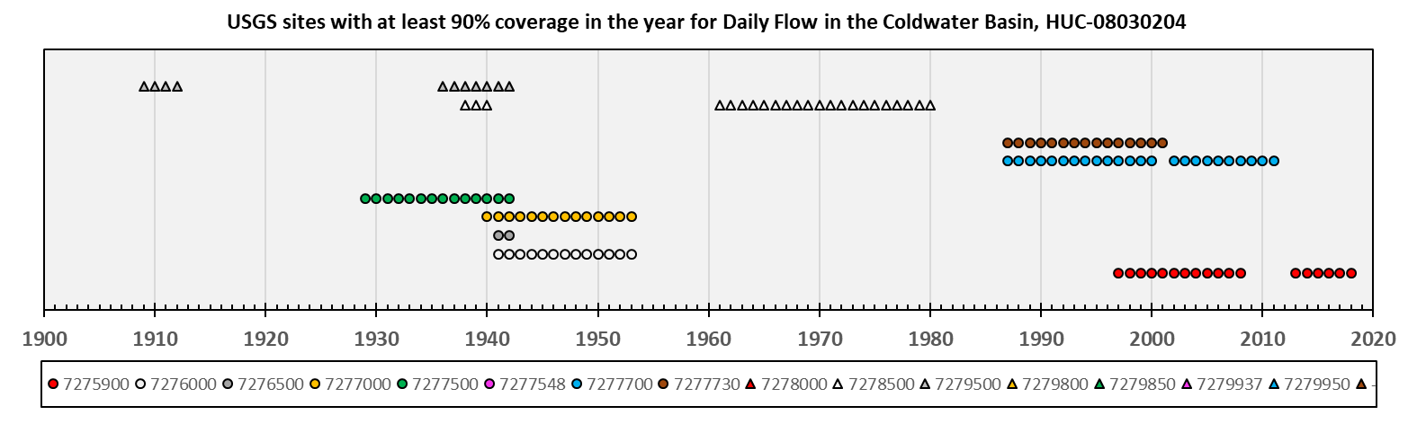
Flow data coverage in the Bluff Hills basins

Slide 11
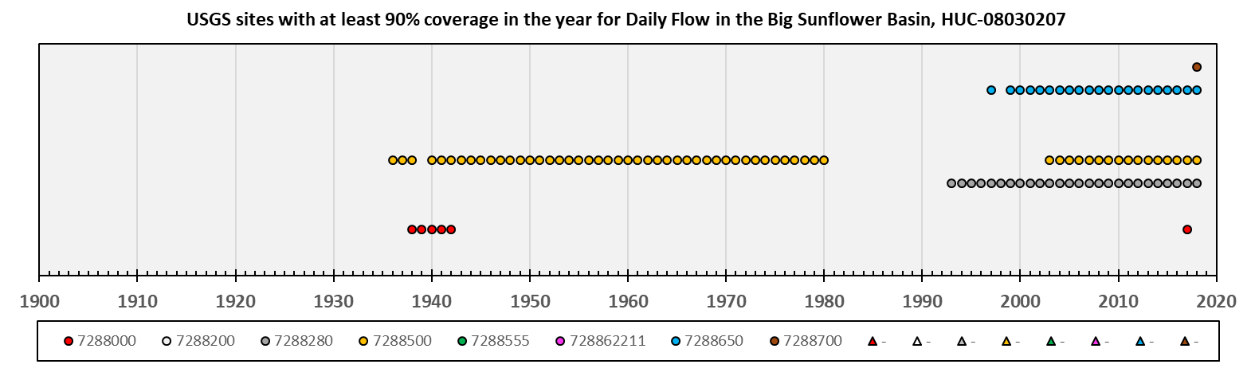
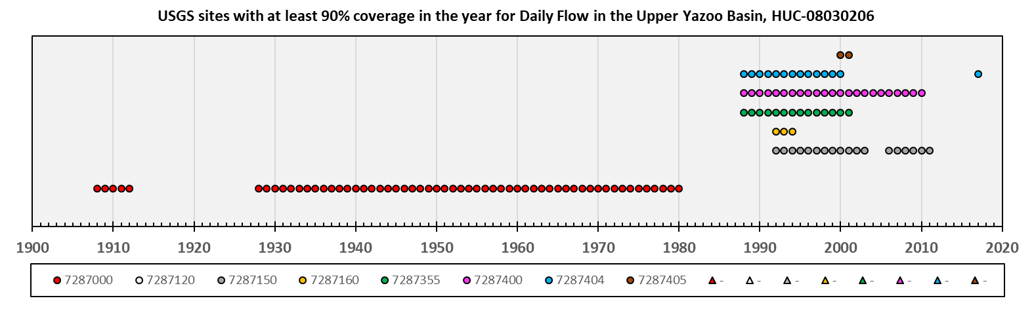
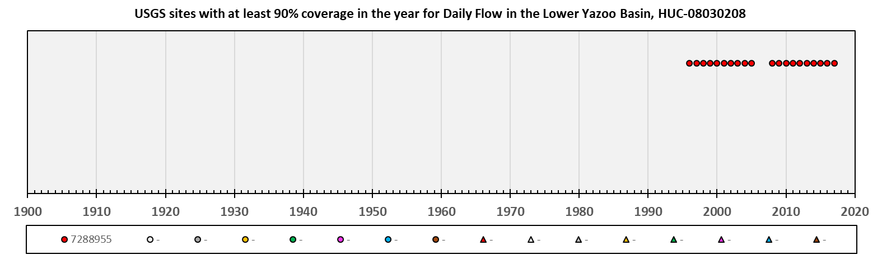
Flow data coverage in the Delta Plain basins

Slide 12
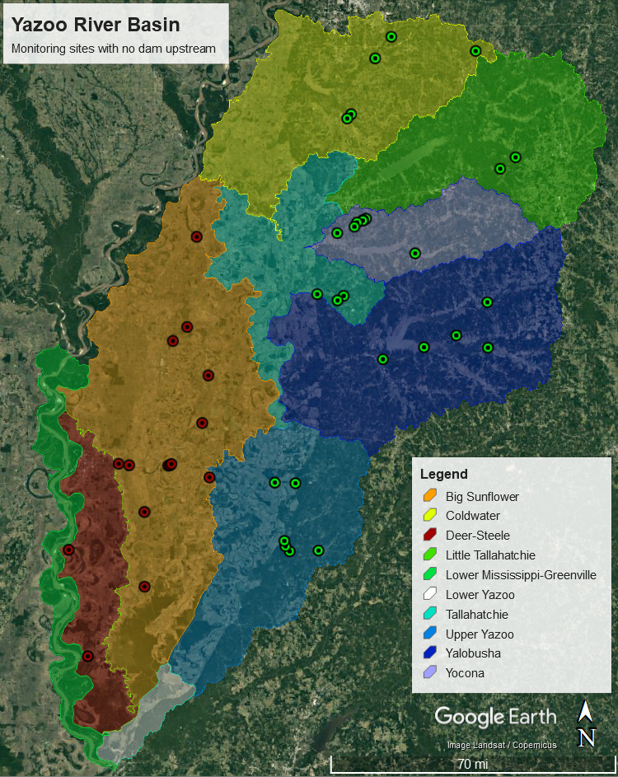
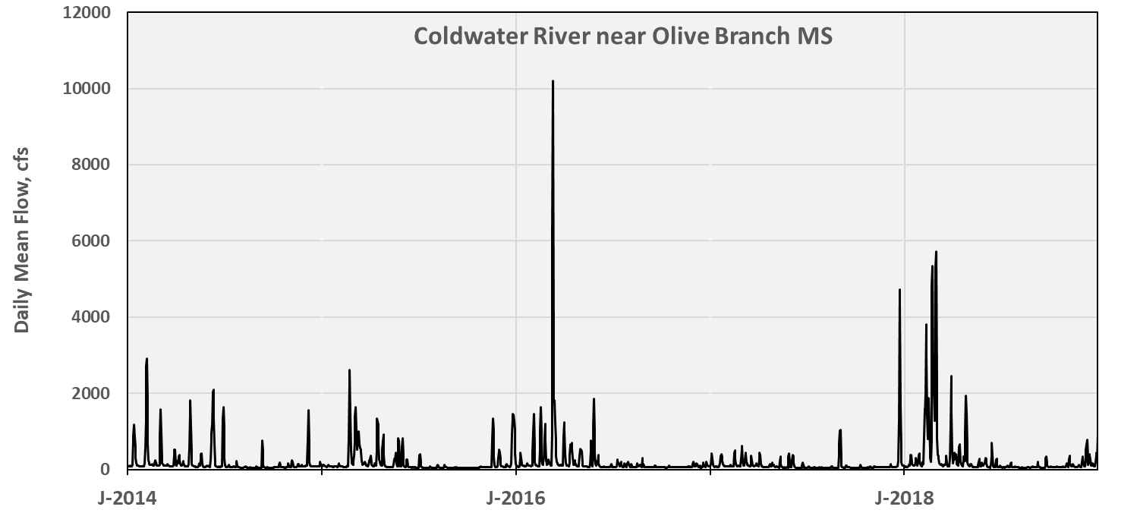
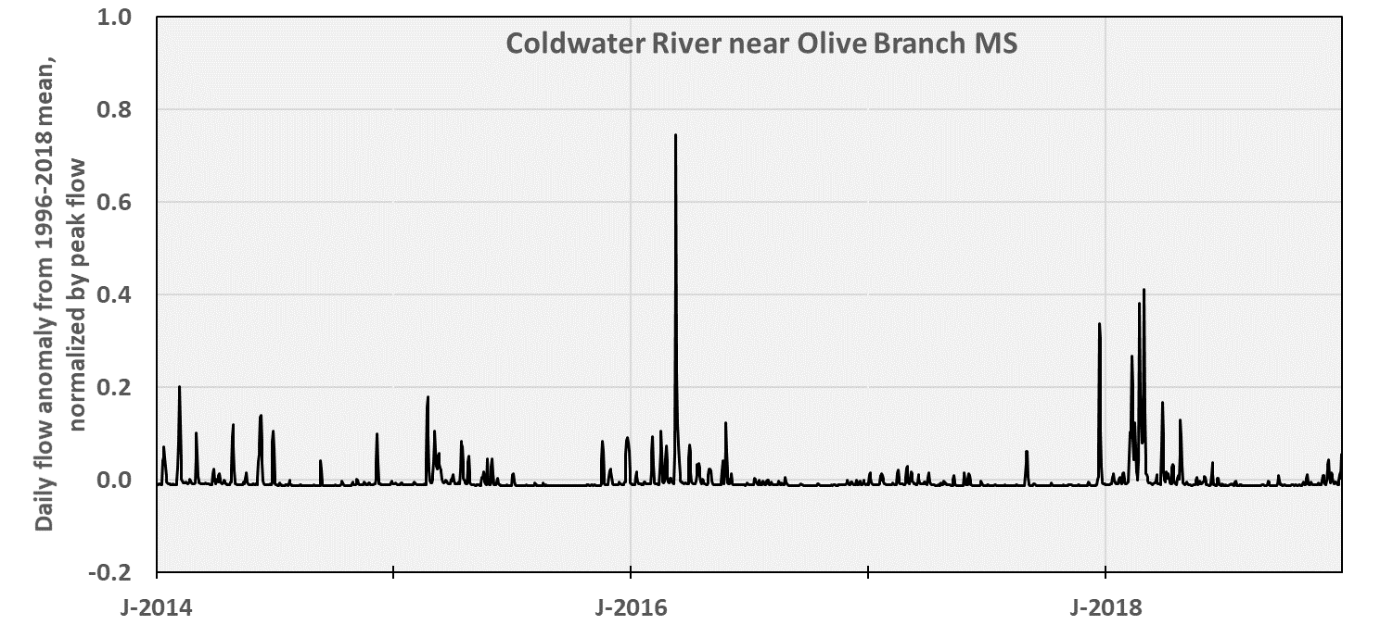
Flow for sites with no dams upstream – Bluff Hills

Slide 13
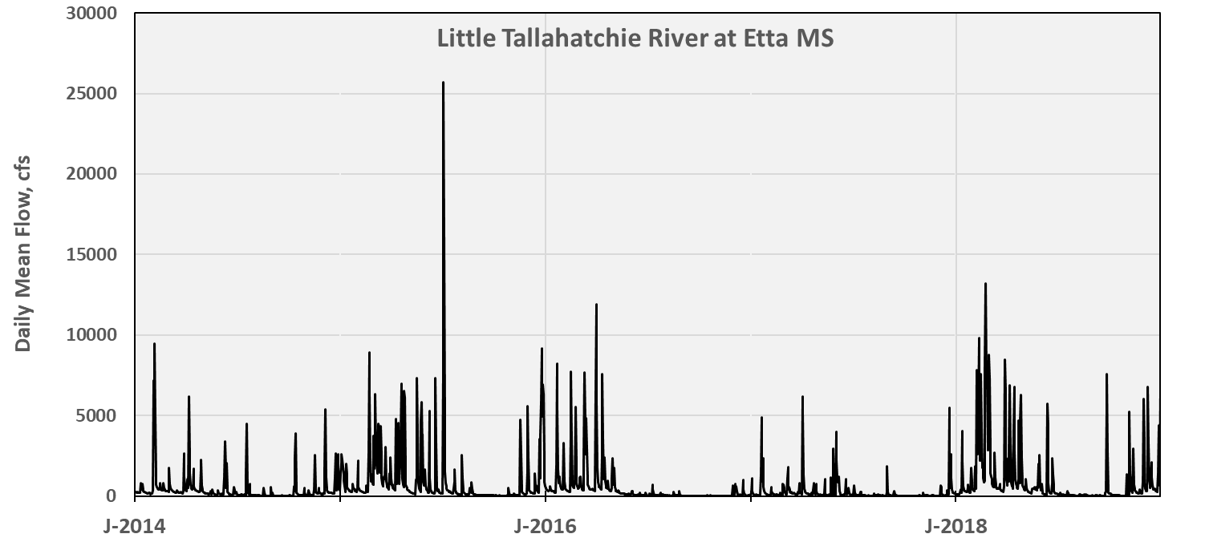
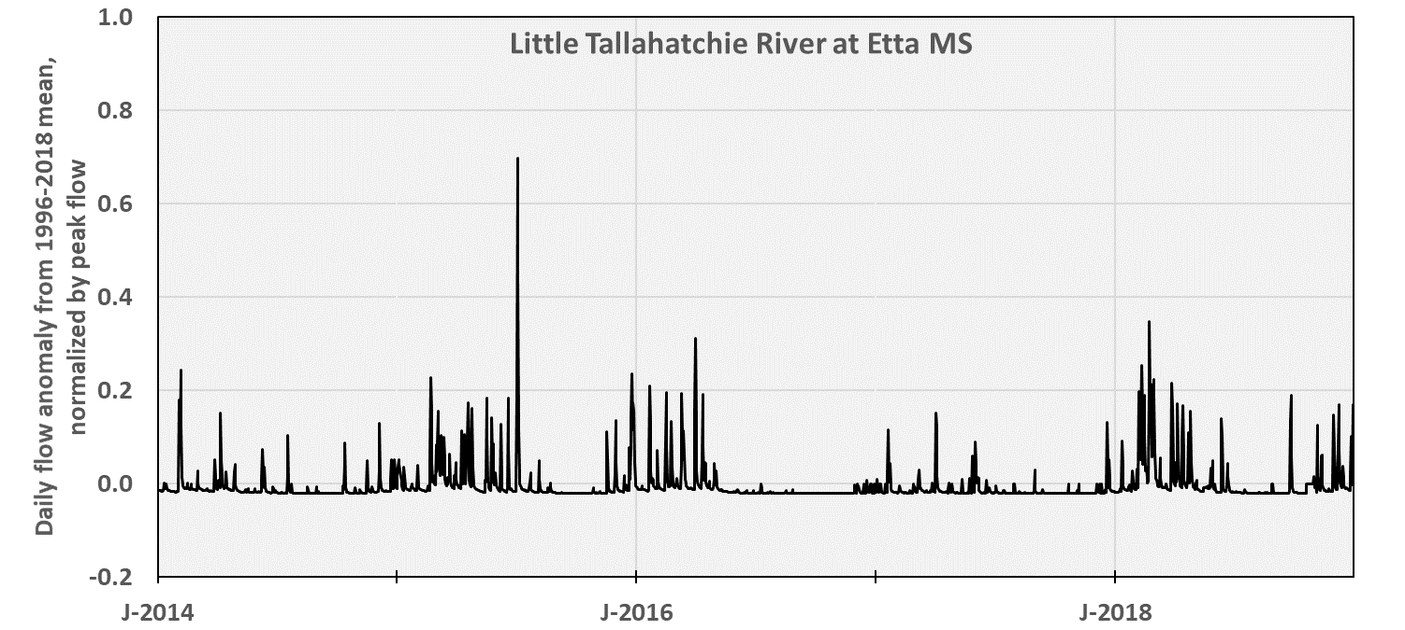
Flow for sites with no dams upstream – Bluff Hills

Slide 14
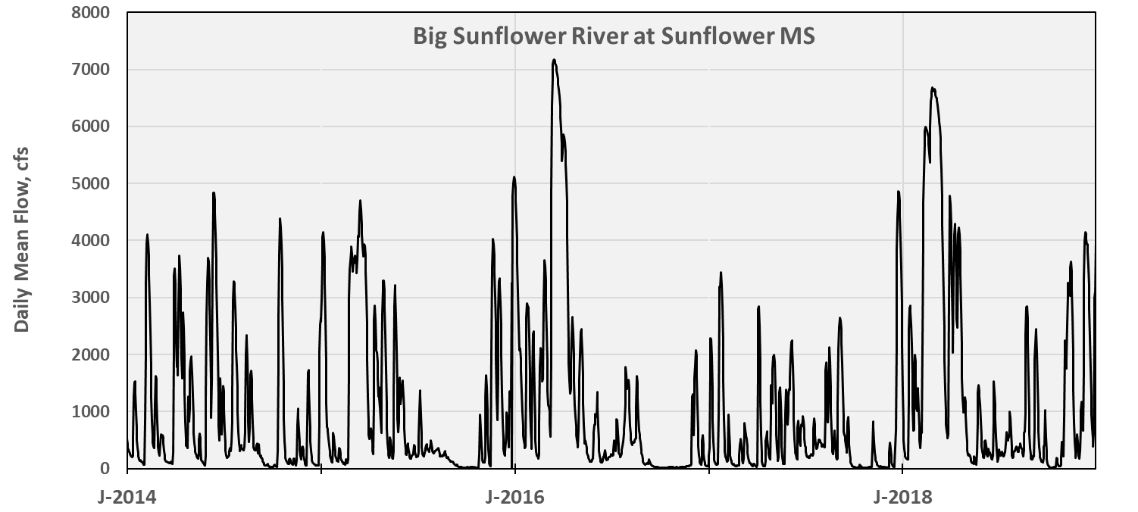
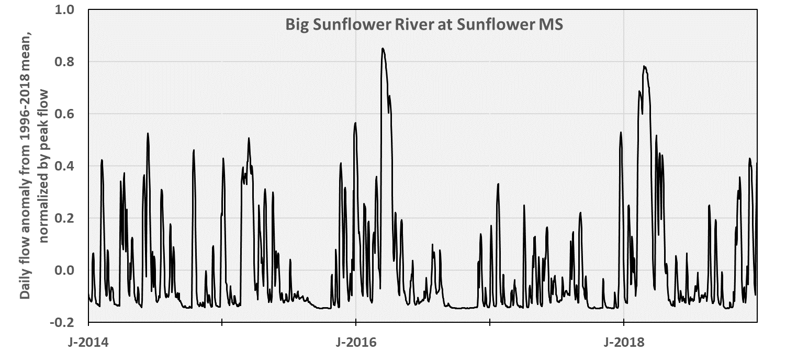
Flow for sites with no dams upstream – Delta Plain

Slide 15

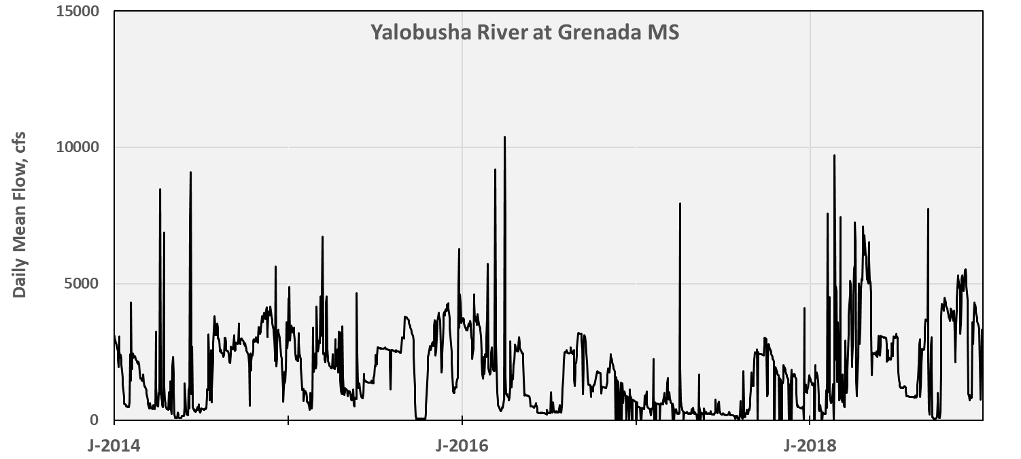
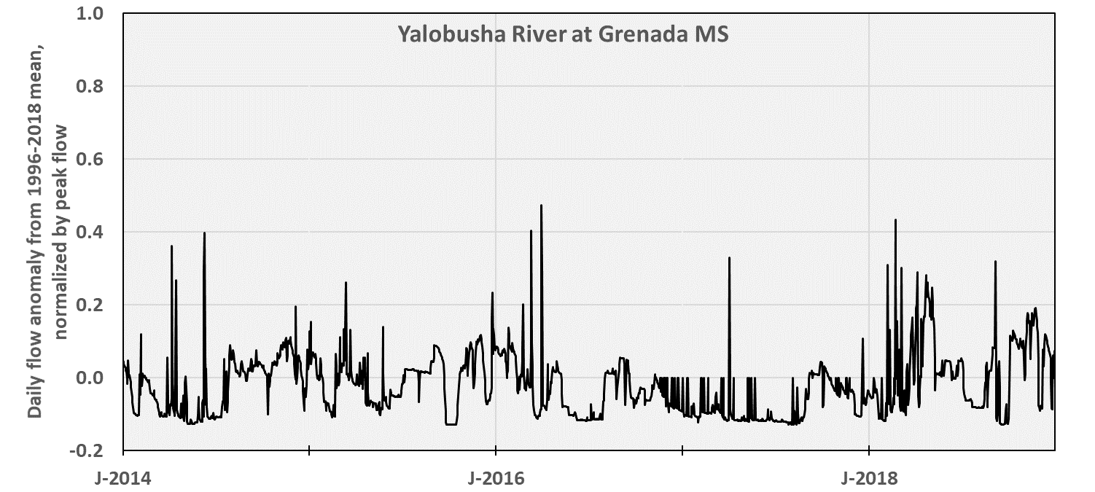
Flow for sites with a dam upstream – Bluff Hills

Slide 16
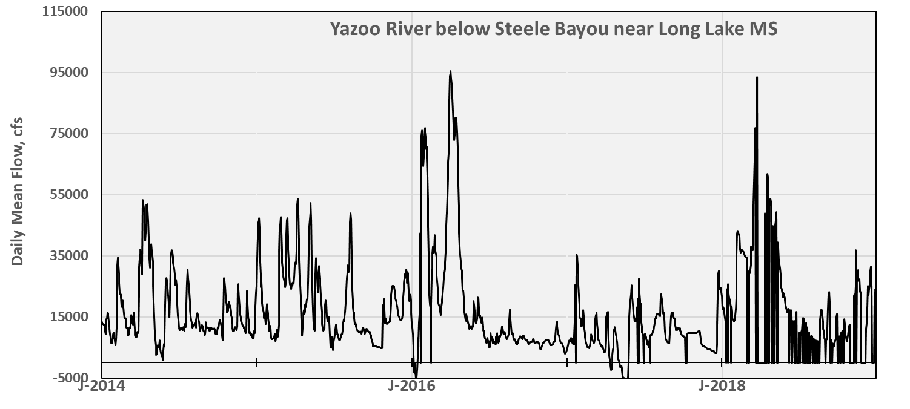
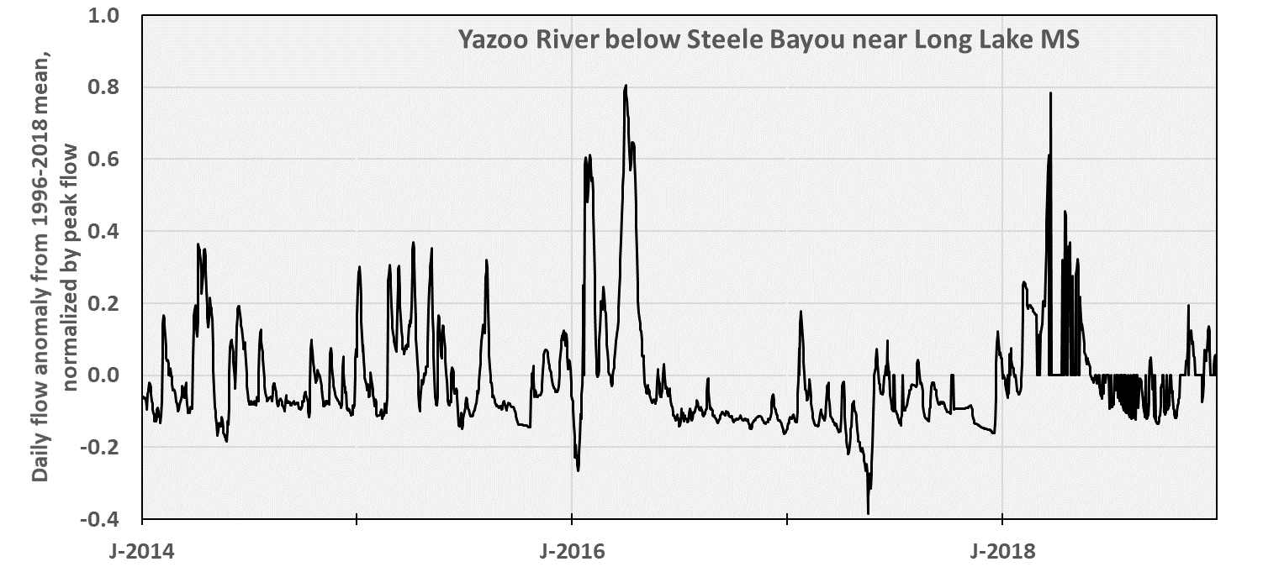
Flow for sites with a dam upstream – Delta Plain

Slide 17
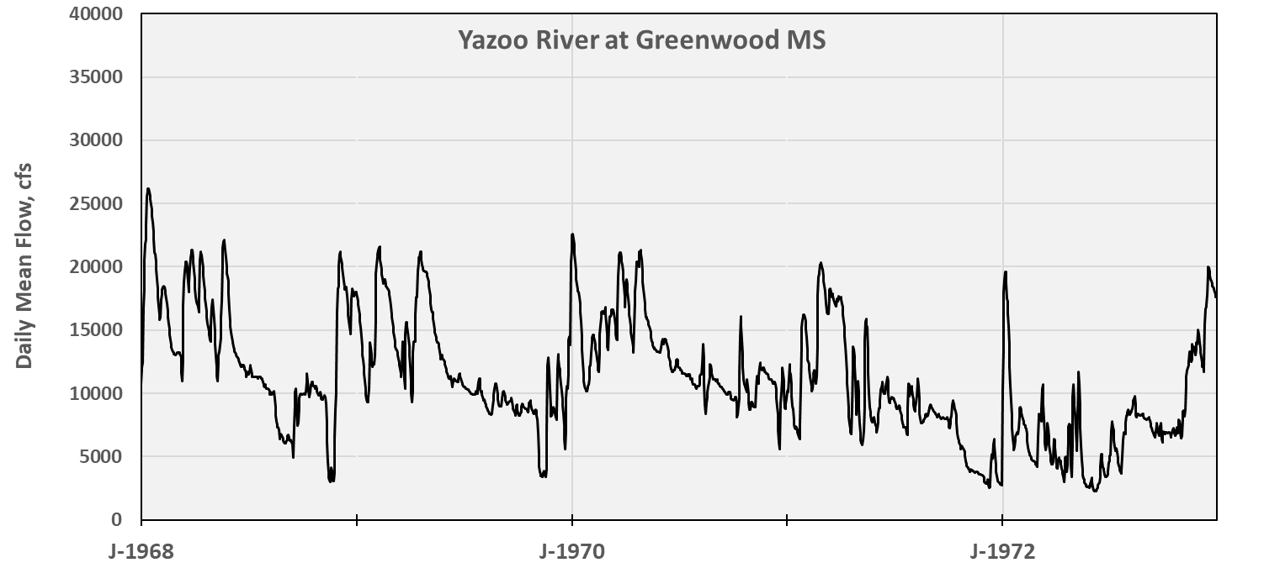
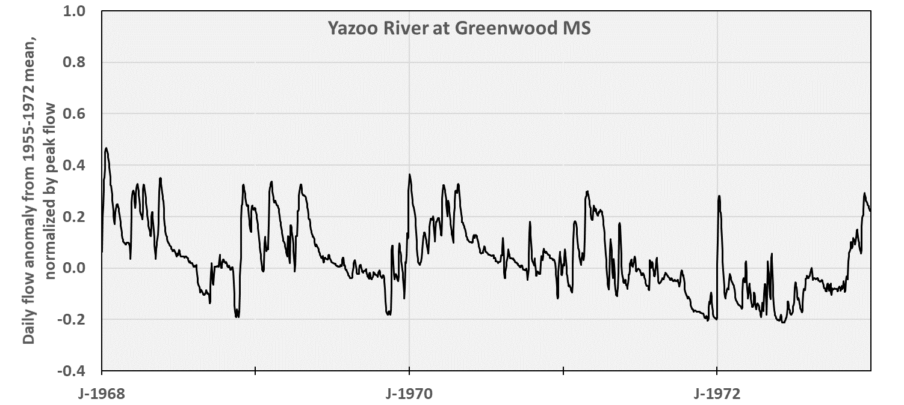
Flow for sites with a dam upstream – Delta Plain

Slide 18
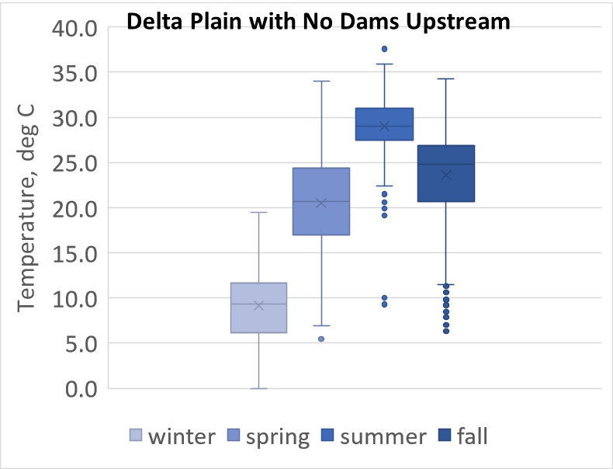
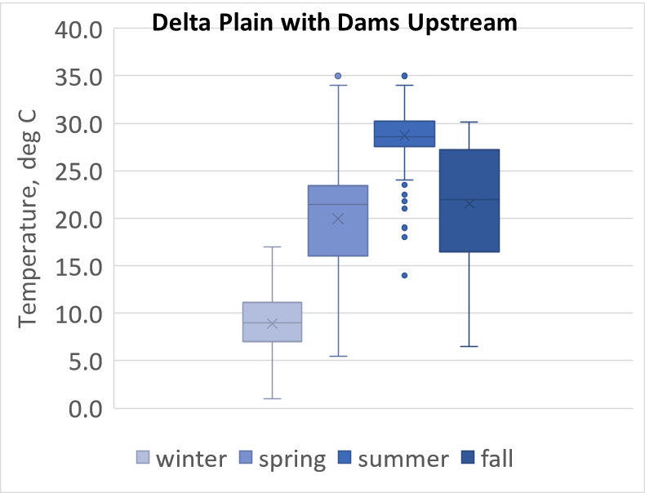
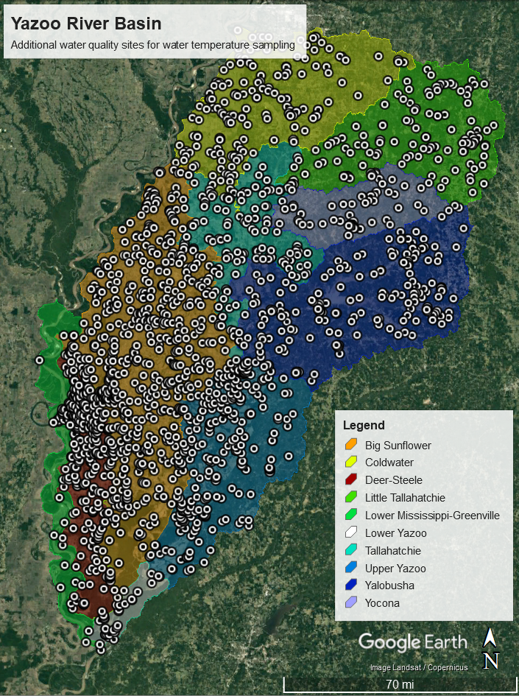
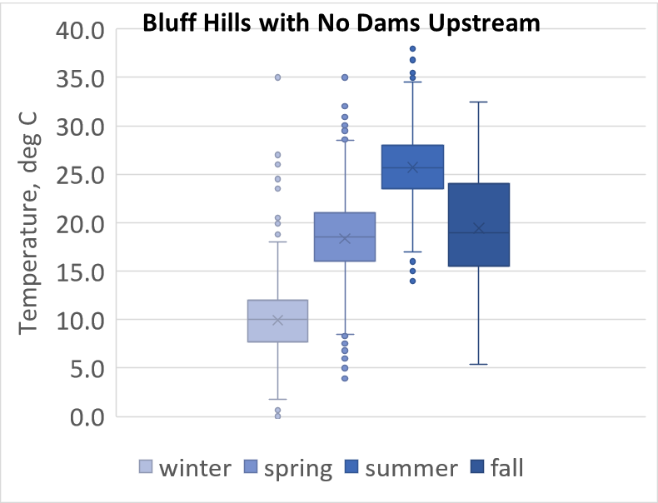
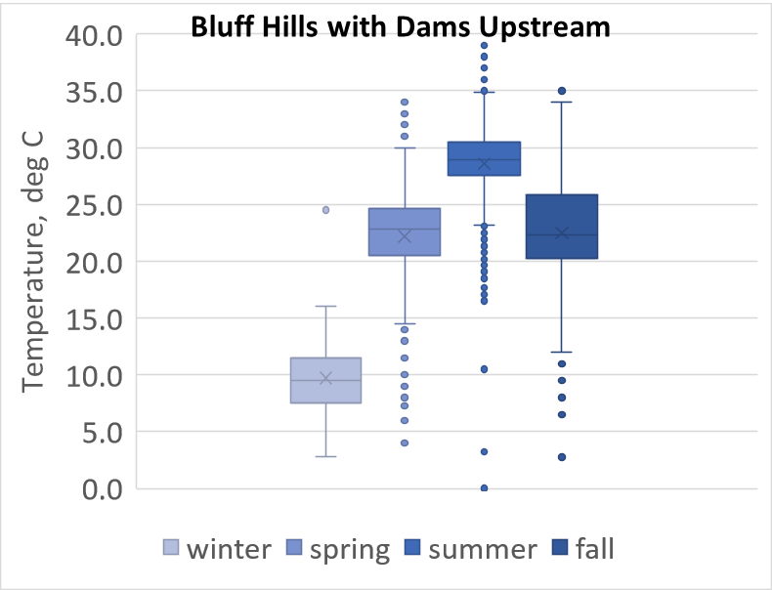
Water Temperature
Map shows all sites (including wells) – only surface water samples were included in this analysis.

Slide 19
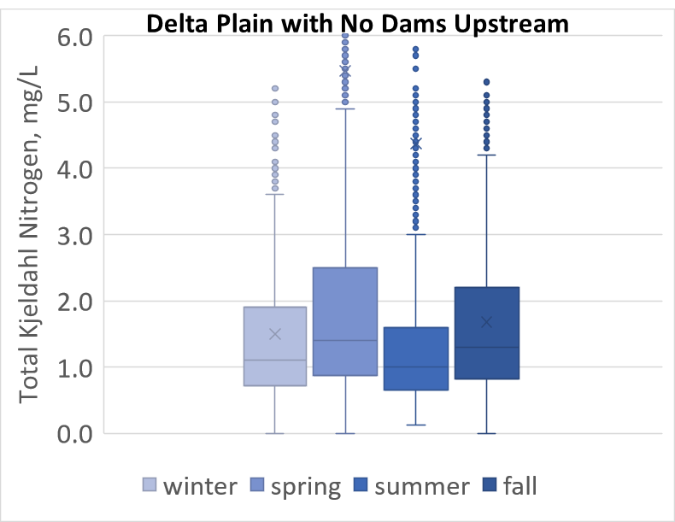
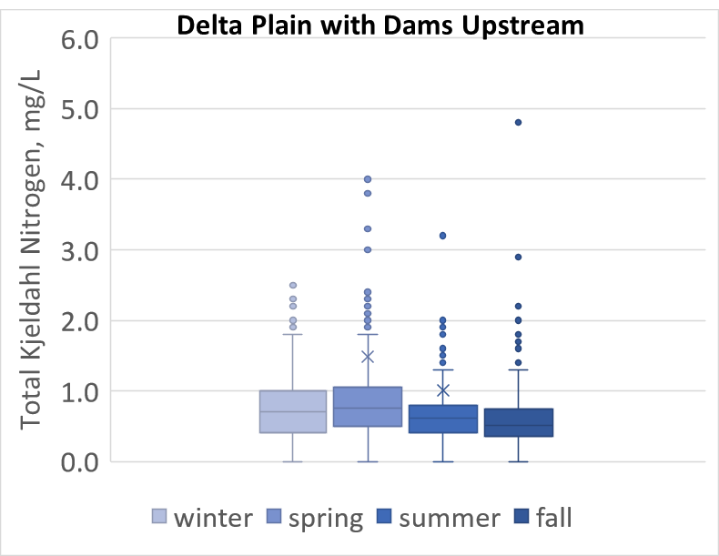
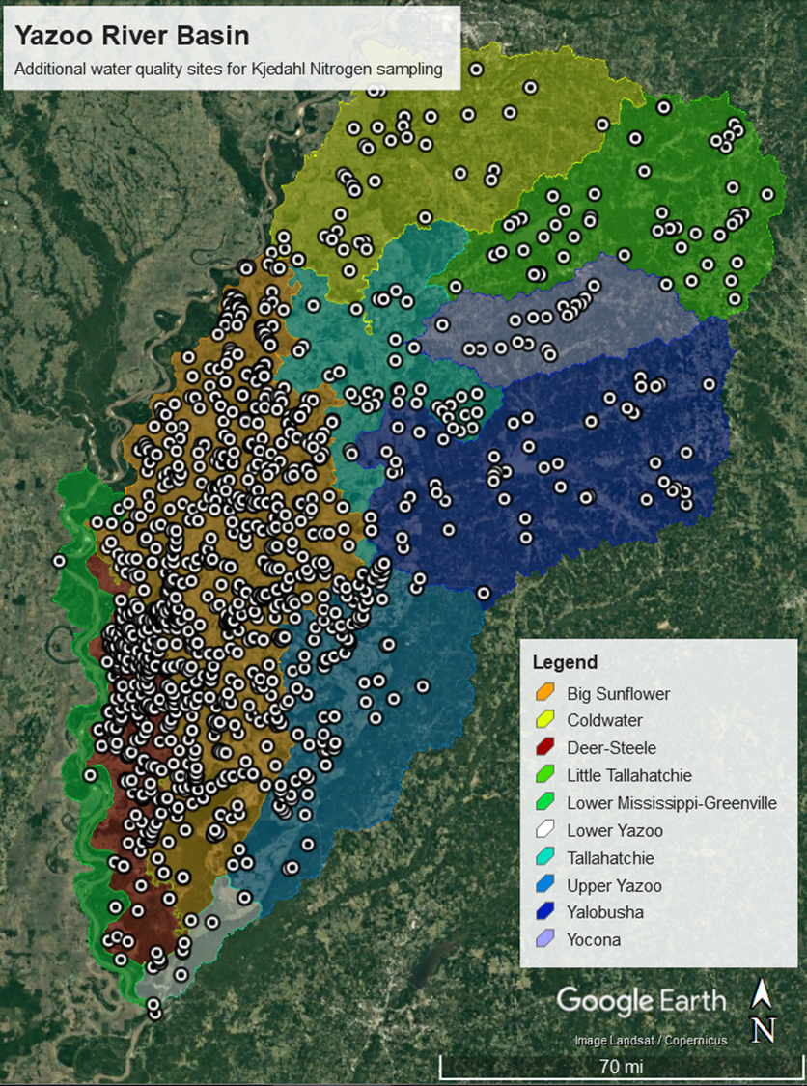
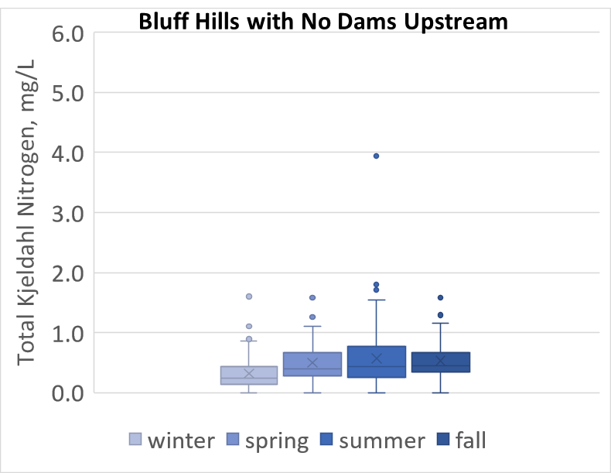
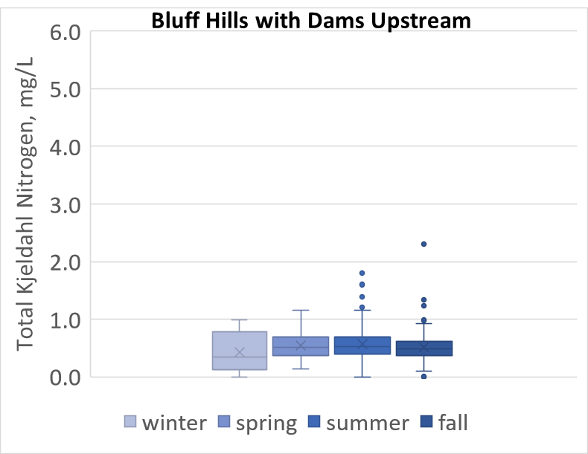
Total Kjeldahl Nitrogen
¹L.O.C. = 0.69 mg/L
¹L.O.C. = 0.69 mg/L
Map shows all sites (including wells) – only surface water samples were included in this analysis.
¹US EPA (2001)
²US EPA (2000)
²L.O.C. = 0.3 – 0.36 mg/L
²L.O.C. = 0.3 – 0.36 mg/L

Slide 20
Challenges & Improvement Observations
Regardless of location with Yazoo basin, TKN concentrations are at or above levels of concern
Reservoir controls have clear impacts on seasonality of flows
Temperature may not be largely impacted by reservoir controls
TKN concentrations appear to have less seasonality downstream of dams
Entire Delta Plain (aside from the Yazoo mainstem) does not have dams

Slide 21
Challenges & Improvement Observations
This system can essentially be set up as a suite of paired watersheds
Test landuse/topographic/geologic differences (n = 6)
Sunflower basin vs five basins in Bluff Hills above dams
Test impact of dams/reservoir operations (n=4)
Upstream and downstream
History of data collection is rich
A thorough statistical design could be set up to examine these impacts over the past 50-60 years (post dam construction in the 1940s)
Will have less ability to do this analysis on data sets that need to be flow-weigthed (not many coupled flow-constituent timeseries)
The need for improvement is high – many impaired streams
Can use the paired watershed approach to test mitigation/restoration options

Slide 22
References
Bryant, M.D. (2010). Past and Present Aquatic Habitats and Fish Populations of the Yazoo-Mississippi Delta. General Technical Report SRS-130. USDA Forest Service – Southern Research Section. Stoneville, MS.
De Cicco, L.A. and Hirsch, R.M. (2014). The dataRetrieval R package. United States Geological Survey.
Flowers, J.C. (2016). Images of America: Clarksdale and Coahoma County. Carnegie Public Library. Arcadia Publishing.
Mississippi Department of Environmental Quality. (2006). Citizen’s Guide to Water Quality in the Yazoo Basin.
Parajuli, P.B. and Kim, H. (2012). Yazoo River Basin Assessment: Preliminary Report. Bulletin 1202. Mississippi State University, Mississippi Agricultural & Forestry Experiment Station.
U.S. Environmental Protection Agency. (2000). Ambient Water Quality Criteria Recommendations Information Supporting the Development of State and Tribal Nutrient Criteria Rivers and Streams in Nutrient Ecoregion IX. U.S. EPA Office of Water. https://www.epa.gov/sites/production/files/documents/rivers9.pdf
U.S. Environmental Protection Agency. (2001). Ambient Water Quality Criteria Recommendations Information Supporting the Development of State and Tribal Nutrient Criteria Rivers and Streams in Nutrient Ecoregion X. U.S. EPA Office of Water. https://www.epa.gov/sites/production/files/documents/rivers10.pdf
U.S. Environmental Protection Agency. (2013). Level III and IV ecoregions of the continental United States. Corvallis, Oregon, U.S. EPA National Health and Environmental Effects Research Laboratory. https://www.epa.gov/eco-research/level-iii-and-iv-ecoregions-continental-united-states.

